Slide 1

Digital Electronic voting machine using Arduino
Mini Project
Presented by:
IV B.Tech ECE-C Section
Batch No. ( C 18)
M.A.A.Ansari (17481A04C9)
M.Bhagya Raj (17481A04D1)
B. Pavan Kalyan (18485A0431)
Date : 23-02-2021
Under the guidance of
Mrs.L.Padmalatha
Assistant Professor
Department of ECE
Gudlavalleru Engineering College

Slide 2
CONTENTS :
Objective
Introduction
Abstract
Block Diagram
Tools Required – (Software and Hardware)
Functions
Schematic Diagram
Advantages, Disadvantages and Applications
Outcome of the Project
Result
Conclusion
References

Slide 3
Objective
The main objective of this experiment/project is to demonstrate the usage of a digital electronic voting machine which is to be used in any quiz games, voting polls etc..
After the end of this project, we can learn how a Arduino along with a source code implements electronic voting at real time and also provide desired results instantaneously.

Slide 4
INTRODUCTION
We all are so fascinated to see quiz shows or voting polls where we see the participants voting for their favorite options available and wonder how that machine/device actually works.
The Electronic voting machine is one such device where the operation of the device is explained in an easier way along with results which are obtained at any instant of time by just clicking one button.

Slide 5
Abstract
The basic idea behind ​​this digital electronic voting machine project is to build an electronic voting machine that will help to avoid the manipulation of the manual voting system and eliminate previous versions of electronic voting. This Digital voting system is simple, portable, cheap, and very effective.
We can also see the results of the voting at real time at any instant of time.
It is user friendly and very feasible for the usage.

Slide 6
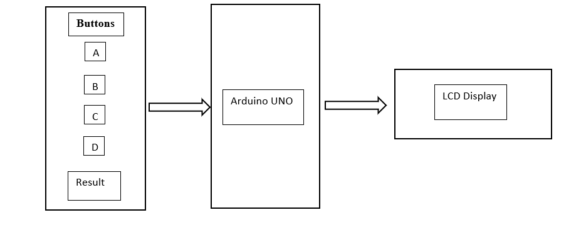
BLOCK Diagram
Circuit
Power supply

Slide 7
SOFTWARE Tools used
Proteus 8 software
Tinkercad
Arduino IDE
HARDWARE Tools used
Arduino UNO
16×2 LCD Display
Push Buttons
Jumper Wires
Breadboard

Slide 8
Functions:
The system is provided with an “N” number of buttons where “N” is the number of a Candidates. Here, voters will be allowed to choose their preferred candidate from the list of buttons. We have an LCD to display the voting for the transparency of the voting. Finally, the results can be calculated automatically by pressing the result button.
In this smart electronic voting machine project, for the demonstration we have used four push Buttons for four different candidates taking part in the program. However, we can increase the number of candidates as per our requirements. When a voter presses any four buttons, the value of the vote will increase each time. After completing the entire voting process, the result button can be pressed to display the result in an LCD Screen.
Arduino UNO is the heart and brain of an electronic voting system. Arduino controls the entire voting process, such as reading buttons, increasing the vote value, generating results, and sending votes and results to an LCD display.

Slide 9
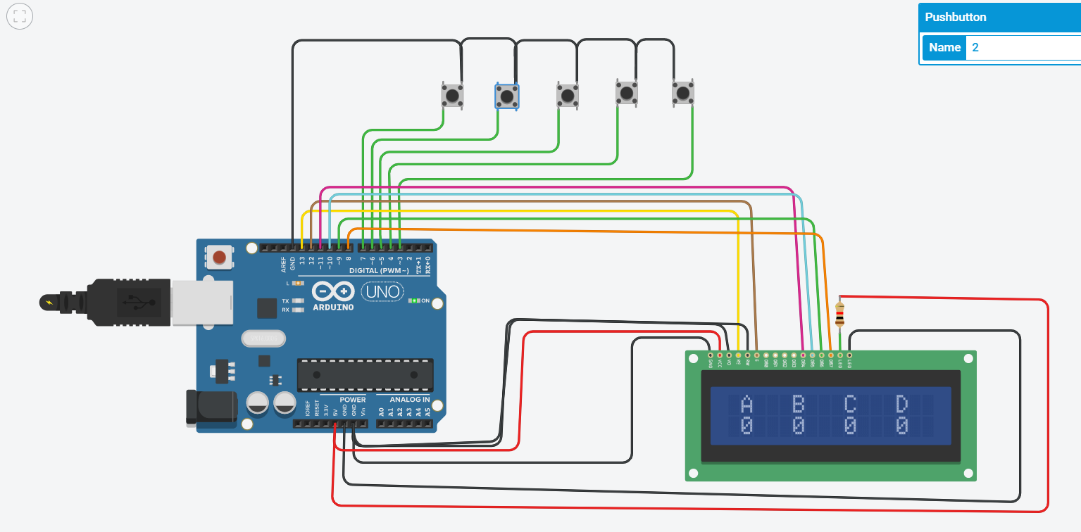
SCHEMATIC DIAGRAM

Slide 10
Advantages
It will provide the results at real-time at any instant of time.
It is user friendly and easier to use without any perquisites.
DISADVANTAGES
There will be no ballot secrecy.
There may be chance of system collapse.
Rigging may also be a case.
Applications
It is used in quiz shows.
It can be used in elections.
It can also be used to take a opinion or survey poll.

Slide 11
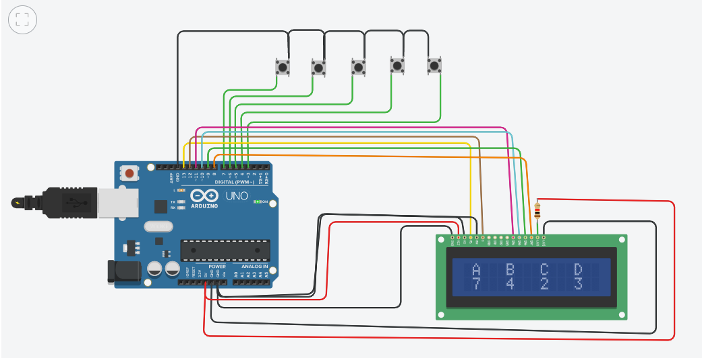
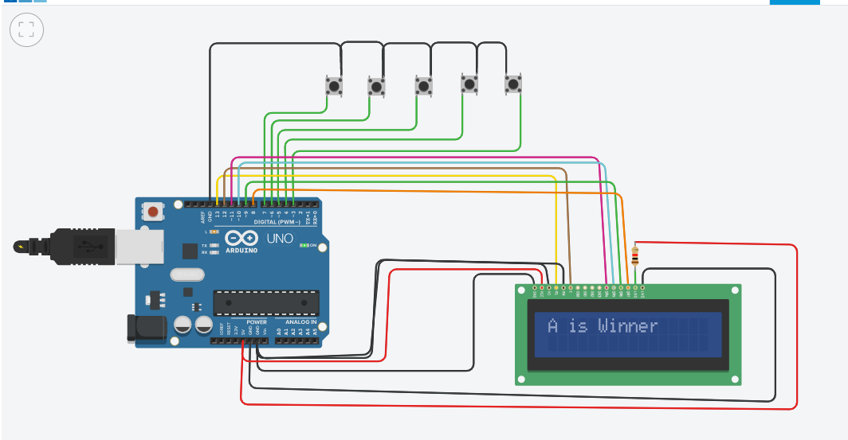
OUTCOME OF THE PROJECT
11

Slide 12
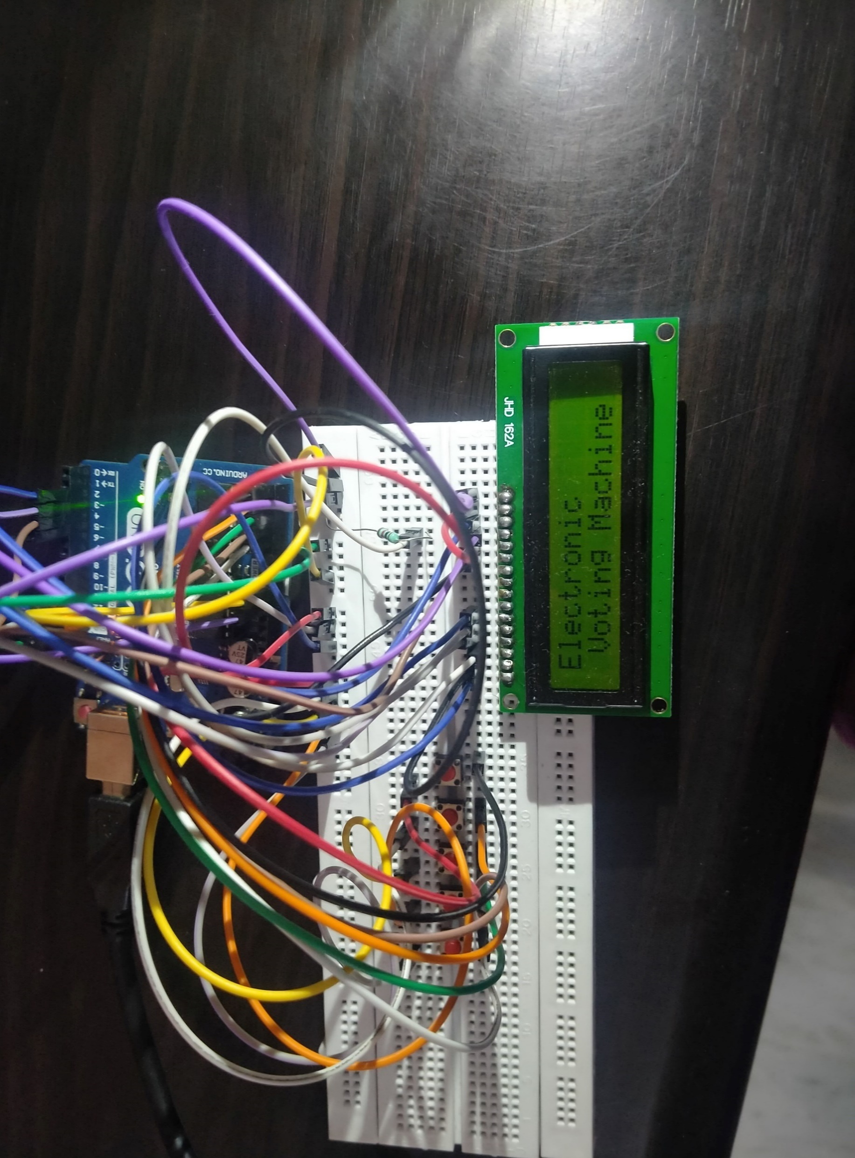
When Arduino and LCD display is given supply, then the following displays

Slide 13
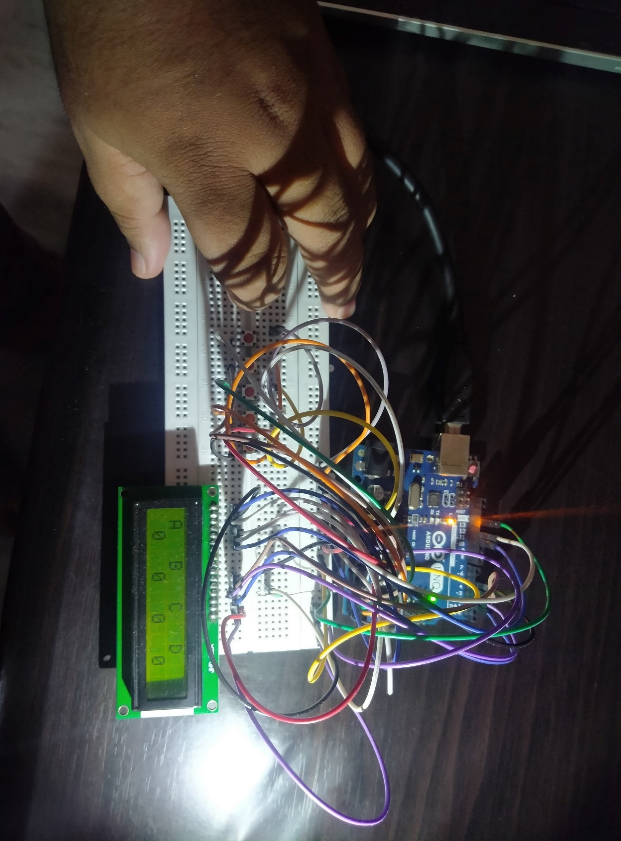
After 2 seconds, zero count values are displayed as follows for each option

Slide 14
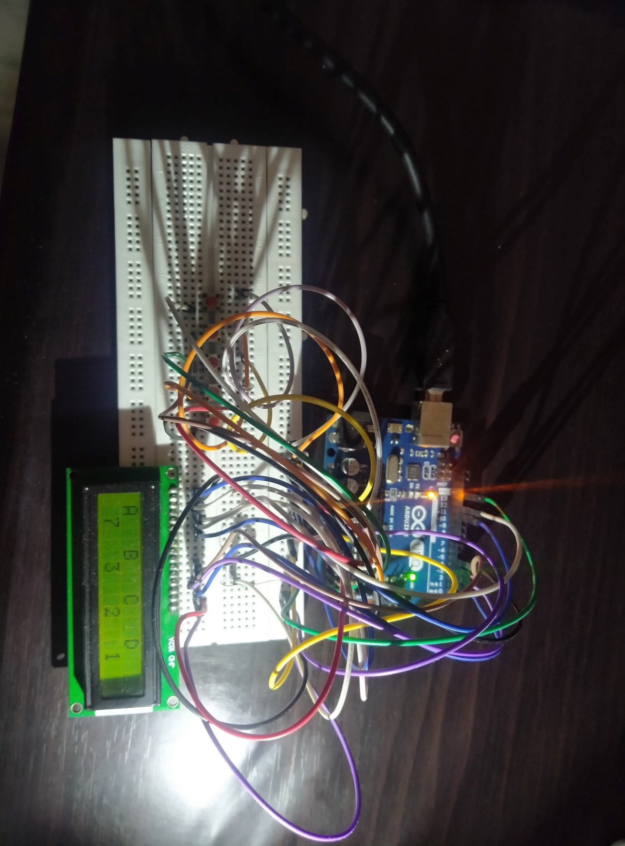
Count value increments for each options with respect to the number of times users press respective push buttons.
Here A has 7 votes which is highest

Slide 15
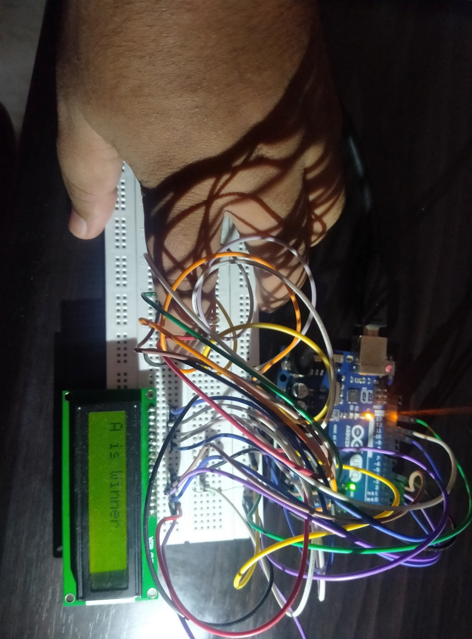
Because A has highest votes, it displays
A is winner

Slide 16
Conclusion
From the above implementation we have observed how a digital electronic voting machine actually works using the Arduino and a user source code and also observed the results of the voting at real-time.

Slide 17
References
https://circuitdigest.com/microcontroller-projects/electronic-voting-machine-using-arduino
https://how2electronics.com/smart-electronic-voting-machine-using-arduino/

Slide 18
Thank you
Any Queries
?

